Slide 1
Introduction to Tools
Module 1: 01

Slide 2
Objectives
The File System
Bash Shell
GIT

Slide 3
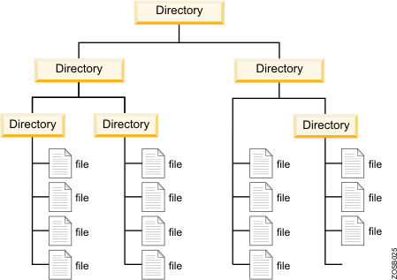
File System
The way a computer organizes data. Includes Folders (or Directories) and Files
Organized into a tree structure. All folders are in a another folder, except the ROOT folder (starting folder). All files must be in a folder.
All folders can contain 0 to many folders and/or files.
folder (directory) - purely for organization
files - content (pictures, documents, etc.)
Folders and Files have metadata (properties) associated with them like date modified, names, and permissions (who can do what with that folder or file)

Slide 4
BASH Shell
What is a Shell?
A shell provides a text-based interface to interact with a computer’s file system. In Shell you write lines of code and commands that the computer understands to direct the computer to do what you want it to do.
What is BASH?
There are many types of shells available on computer systems. Each Shell has its own set of commands. BASH is a commonly used shell that is available on Mac OS, Linux, and Windows. While Windows 10 does have a built in BASH Shell, GIT BASH provides a more robust version of the shell.
Why use a shell?
Many programming tasks are more flexible and faster in the Shell
It can be scripted, which means we can write our own reusable commands
Many programming tools do not have graphical user interfaces (GUI), or have more options available in the shell version. Often the GUI for these tools and just for convenience and issue shell commands in the background, so if we don’t understand the shell commands, then we can’t troubleshoot problems we may encounter.

Slide 5
Shell Basics
The Root directory is where the file system begins for the computer. All directories and files on the computer are in the root directory.
The home directory is where the file system that has been assigned to your user begins. The home directory can always be accessed by the ~ alias.
The working directory is the directory that is currently being accessed.
Shells are controlled using commands that tell the computer what you want it to do.
Many shell commands take arguments, which are extra parts of the command that change its behavior.
In Windows, the Bash Shell is accessed using the Git Bash application.

Slide 6
Basic Shell Commands
Command | Description
cd | change directory. ~ specifies the home directory. (cd ~)
pwd | Tells you where you are in the file system
ls ls -la | list all files and folders in a directory. -a (shows all files and folders) ls -a -l (shows details about the files and folders) ls - l. can be used together as ls -la In file details first letter is d for a directory and - for a file.
mkdir <dir name> | Creates a new directory
code <filename> | Creates a file then opens it in Visual Studio Code, or if the file exists it opens it.
touch <filename> | Creates an empty file
cp <file> <new location> | Copies a file
mv <file> <new location> | Moves or renames a file
cat | print contents of a file on the screen
rm | Removes a file or folder with -r (remove all contents). -f (force) - make it happen no matter what.
. is an alias for the current directory
.. is an alias for the parent directory of the current directory.

Slide 7
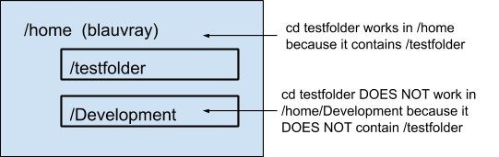
Paths
A Path is text representation of where a directory or file is located in the File System. Paths can be absolute or relative.
An absolute path is one that starts at the Root of the file system. It points to the same location in the file system regardless of where it is used. Start with / or ~
A relative path is one that starts relative to the current working directory (location). It points to a different location in the file system depending on where it is used. Start with a folder or file name.

Slide 8
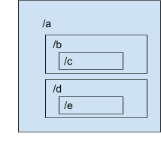
If we had the following file system, and our current location was /a/b/c?
To change directory with the cd command:
What relative path would change to /a/b?
cd ..
What absolute path could be used?
cd /a/b
What relative path would change to /a?
cd ../..
What would the absolute path be?
cd /a
What relative path would change to /a/d/e?
cd ../../d/e
What would the absolute path be?
cd /a/d/e

Slide 9
BASH Shell Tips
No news is good news. Many commands only give feedback when there is a problem.
A history of commands is kept. You scroll through past commands using the Up and Down arrow keys.
The tab key can be used to autocomplete a path. It only completes if you have enough unique characters for it identify the directory or file you are trying to identify.
You can press tab every few letters to autocomplete the path to save time and avoid spelling errors.

Slide 10
Introduction to GIT
Version Control is a system that records changes to a file or set of files over time, so previous version can be recalled.
Teams can go back in time before a bug occured to compare to a working version
Sharing code among team members is simpler, when we can just share changes in the checkpoint
Team members can develop code in parallel, and then merge their code together when complete
Once you have commited your work to GIT. It is very difficult to lose it, even if you make a mistake!
Let’s developers try things without the risk of losing previous work.

Slide 11
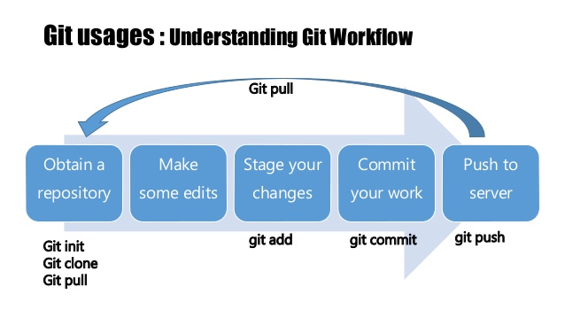
GIT Commands
clone | Get a copy of a repository as a starting point
add | Add changes to the stage
commit | Add changes to the local repository
push | Copy changes from the local repository to the remote repository
pull | Copy changes from the remote repository to the local repository
status | tells us the state files are in in this process
Stages of a File
untracked | File/Folder can be seen by GIT but is not be tracked by GIT
modified | A file/folder has been changed, but not staged
staged | A change has been added
committed | A change has been added to the local repository
GIT Mantra
Commit Early, Commit Often

Slide 12
GIT Workflow
After changes have been made
Add
Commit
Pull & Merge (if working with a partner or team)
Add / Commit changes that were made during the merge
Push

Slide 13
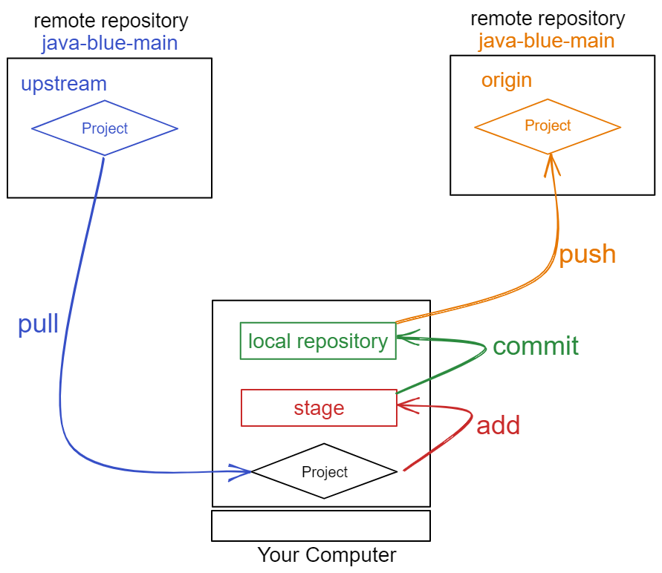
Remote Repositories
yourname-java-blue
upstream java-blue-main
Instructor repository used to get new materials and exercises. Can only pull.
origin yourname-java-blue
Student repository used to backup and submit materials and exercises. Can push and pull.

Slide 14
Getting new materials
In terminal
$ cd ~/source/repos/<yourname>-java-blue
$ git pull upstream main
Watch the output of the command. If it says it was not able to pull the changes, then you may need to add and commit first.
$ git add -A
$ git commit -m “your comment”
$ git push origin main

Slide 15
Submitting your Work (or just backing it up)
In terminal
$ cd ~/source/repos/<yourname>-java-blue
$ git add -A (stages all your changes)
$ git commit -m “your comment” (adds the staged changes to your local repository)
$ git push origin main (pushes the changes to your Bitbucket repository)
Watch the output for failures! If you see a failure, reach out to an instructor ASAP.
You can verify what has been submitted by looking at the file in Bitbucket.
You can push as often as you like. Only the last changes made will be reviewed.

Slide 16
Remember the Workflow!
Get new materials (usually only once per day) git pull upstream main
complete the exercises
Add your changes to the stage git add -A
Commit the changes to your local repository git commit -m “comment”
Repeat 3 & 4 often as you work on your exercises!
Push your changes to Bitbucket to backup and/or submit. (as often as you like) git push origin main
These commands should ALWAYS be run in your local repositories root: ~/source/repos/yourname-java-blue

